Slide 1

Estimating coastal ecosystem health through indices
A case study of anthropogenic pressures in Tampa Bay
Arjun Joshi
Brainstation
Capstone Project
Joshi.Arjun.K@Gmail.com

Slide 2

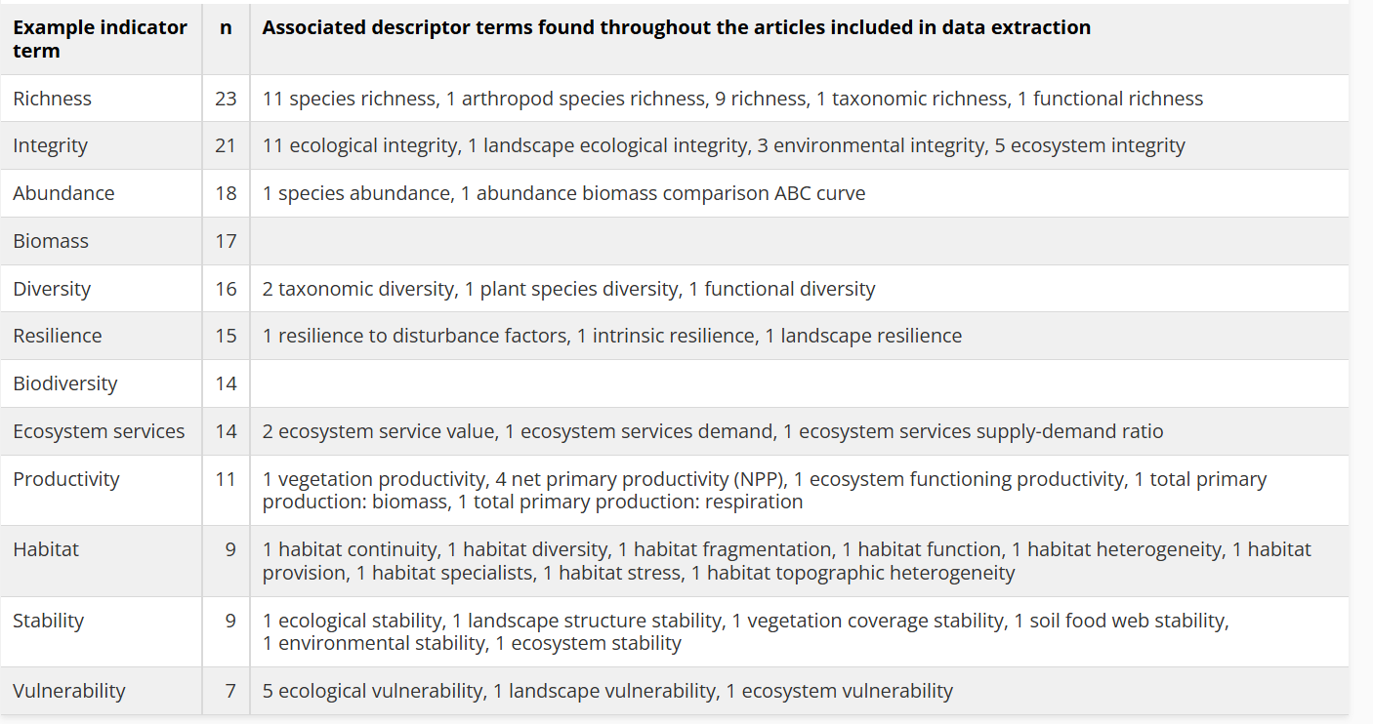
The problem space: environmental indices, lost in translation
Quantitative Indicator Terms

Slide 3
Creating new
“ [The importance of] how terminology descriptors and their use can be understood by [] stakeholders across disciplines, with implications on the dimensions of implicit intrinsic and extrinsic value statements… “

Slide 4
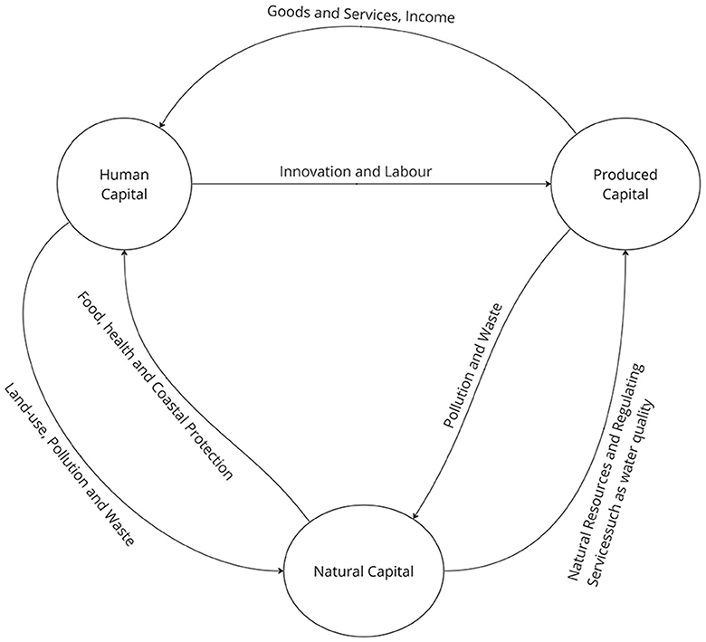
What is an environmental index
What is an Environmental Index?
“A composite measure that combines multiple
environmental indicators into a single value…”
“ …typically developed to provide an overall
snapshot of some feature”
Source:
https://onlinelibrary.wiley.com/doi/abs/10.1002/9781118445112.stat07691#:~:text=Abstract,in%20constructing%20an%20environmental%20index
https://www.linkedin.com/advice/1/how-can-you-use-environmental-indicators-indices-skills-economics#:~:text=to%20be%20featured.-,1%20What%20are%20environmental%20indicators%20and%20indices?,their%20environmental%20performance%20or%20impact

Slide 5

Reframing, pivot
Purpose of the Study and Future Space for Expansion:
Selection of the optimal or most positively impacting mitigation feature…using[ing] indices of negative environmental impact.
Originally evaluating performance of models through predictions of diversity (through the Shannon Diversity Index)
New approach:
Test along with Shannon Diversity Index as an engineered feature, to predict well established, academically vetted peer-reviewed local index
- Data Issues
Existing Information
Unexpected findings during EDA

Slide 6
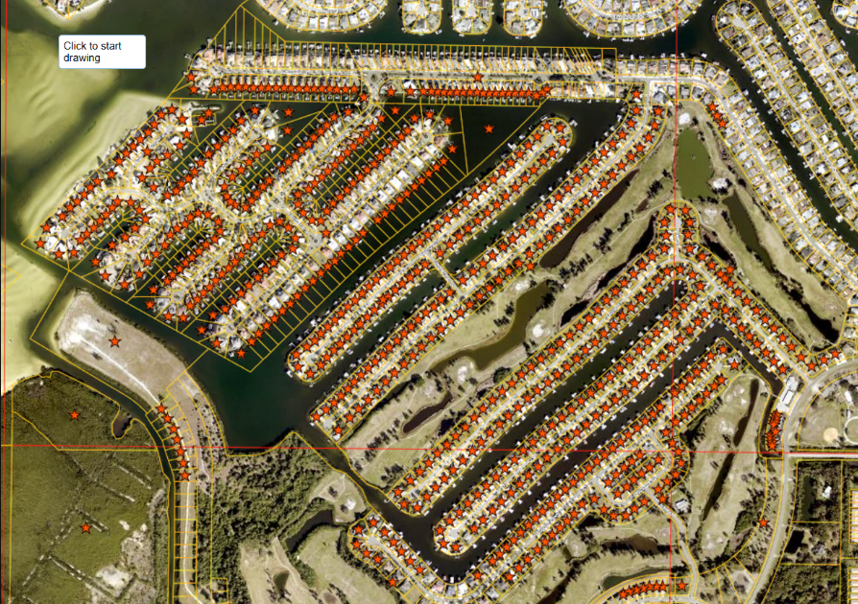
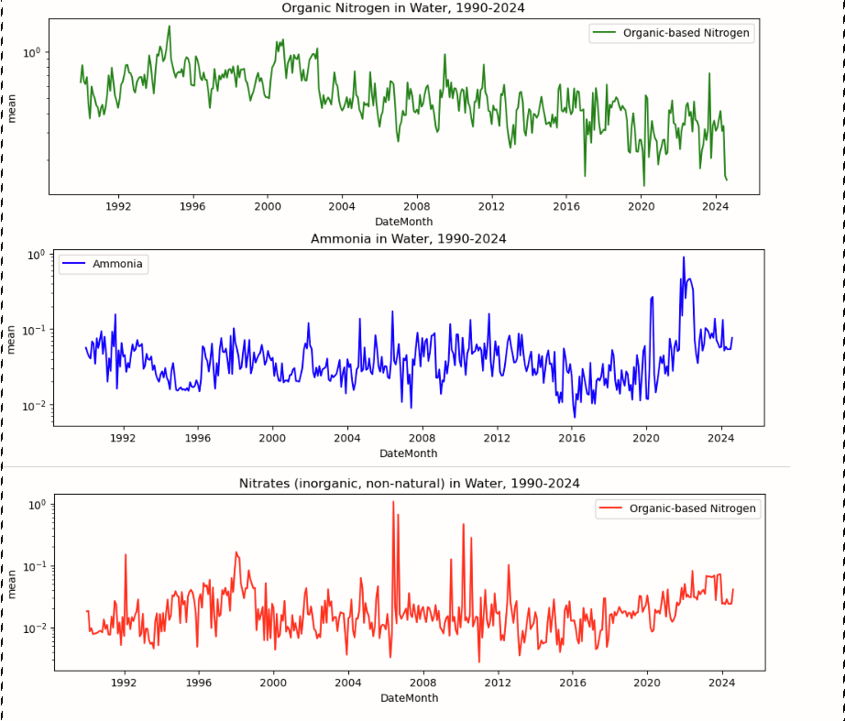

Anthropogenic pressure index
Hypothesis:
There is a statistically significant relationship between a proposed A.P. Index
with well established, academically vetted indices of ecosystem health
of Tampa Bay.
- Artificial, Harmful Nitrate Concentrations
(Associated With Fertilizer)
Population Growth (Annual change, Total, Region specific)
Coastal Development
Land Sales
Annual New Construction
Change in Land Use
Transform then standardize data, using weights to adjust for relative
Impact of a given feature. This is adjustable to any localized system.
Residential Construction
Emphasis on “waterfront”
$$\begin{matrix}API=ω_{1}z_{1}+ω_{2}z_{2}+…+ω_{n}z_{n} \\ \end{matrix}$$
Weighted Sum Model
(Aggregate Index)

Slide 7
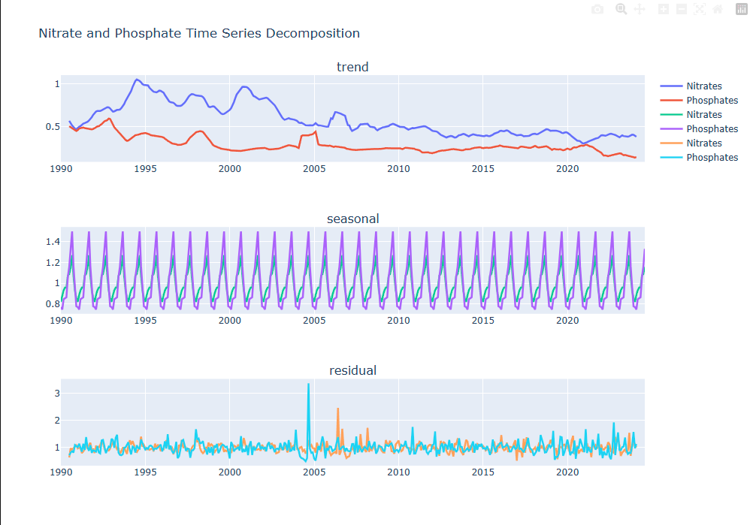
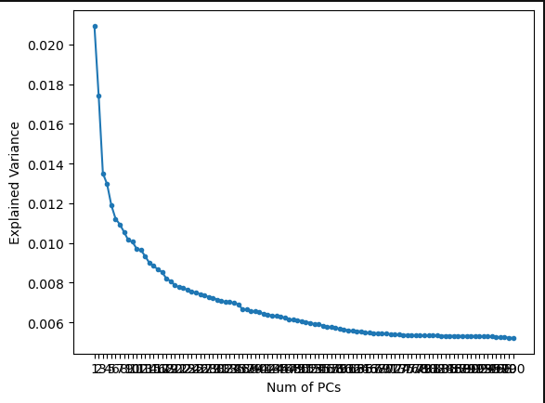
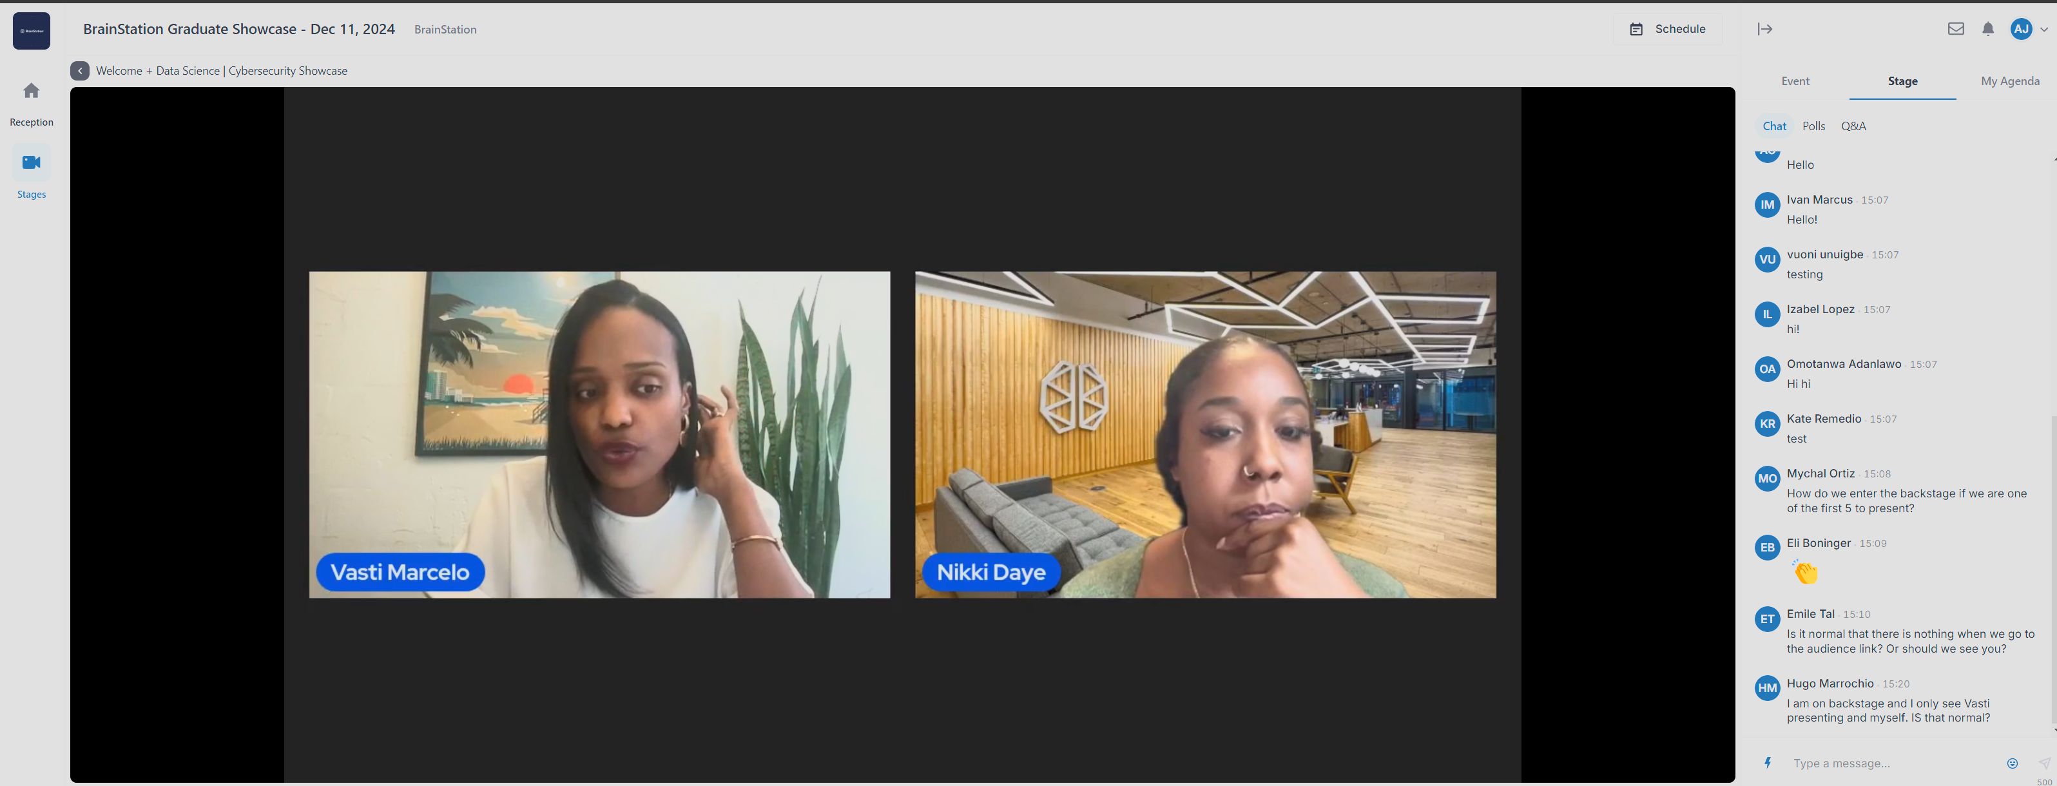
Modelling approaches & performance
Modelling Approaches
Linear Regression
Lasso, Ridge Regression (L1/L2 Regularization)
SARIMAX
Seasonal decomposition
VAR
Recurrent Neural Network
Long Short Term Memory ****
First Model: Multivariate Linear Regression.
Score: 0.2523
RNN (LSTM): Predicting TBNI using iterations of API, Shannon Diversity Index, WQI
Loss, MSE: 0.035,
n = 45,431
Using Train-Test-Validation Datasets

Slide 8
Implications & Next steps
There’s a method more readily accessible and understandable to the general population without…having to be a scientist!
Further applications
And many thanks to our instructors for all their guidance!

